Slide 1


Lesson 1:
Client requirements
2.1 Planning, creating, modifying and using databases
© SIMPLY TEACH 2024
www.mysimplyteach.co.uk

Slide 2
Learning objective(s):
Plan and design a database in response to the client brief.
Lesson components:
To understand the purpose of a database and its different components
To analyse a client brief for the practice assignment.
To use the client brief and your knowledge of databases to identify success criteria.

Slide 3
Databases
Key terms:
A database is a digital system that is designed to store large amounts of data.
Learning in Context
Online marketplace (e.g. Amazon)
Why are databases used?
Manage data – store, retrieve and manipulate data.
Ensure data integrity - ensuring that certain fields are always populated or that relationships between different pieces of data are maintained.
Enable concurrent access - Multiple users or applications can access a database simultaneously,
An inventory management database (i.e. managing the products they sell)
Product name
Description
Price
Quantity in stock
Database components
Tables
Forms
Queries
Reports

Slide 4
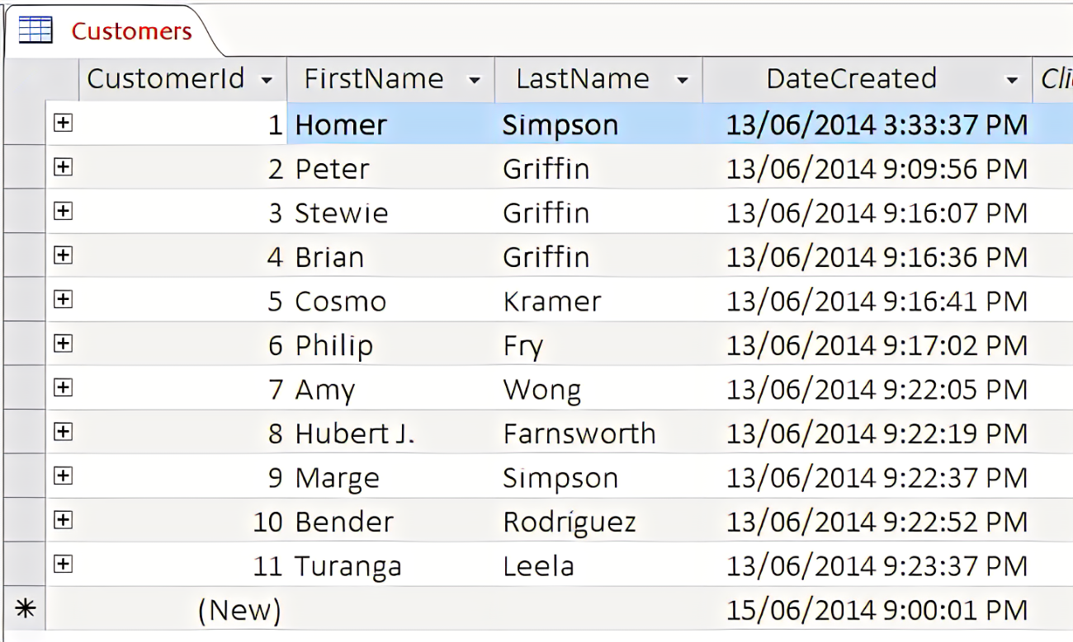
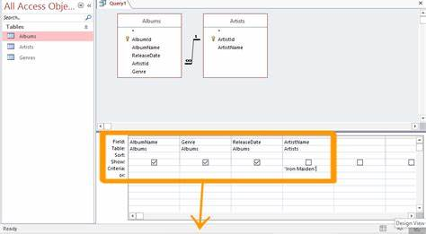
Database components
A table organises data into rows (records) and columns (fields). Each table represents a specific entity or object.
A query is used to retrieve specific data from one or more tables in a database. They allow users to filter, sort, and manipulate data based on predefined criteria.

Slide 5
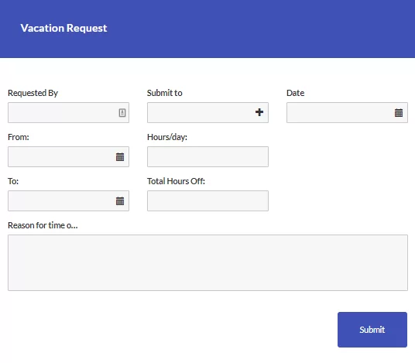
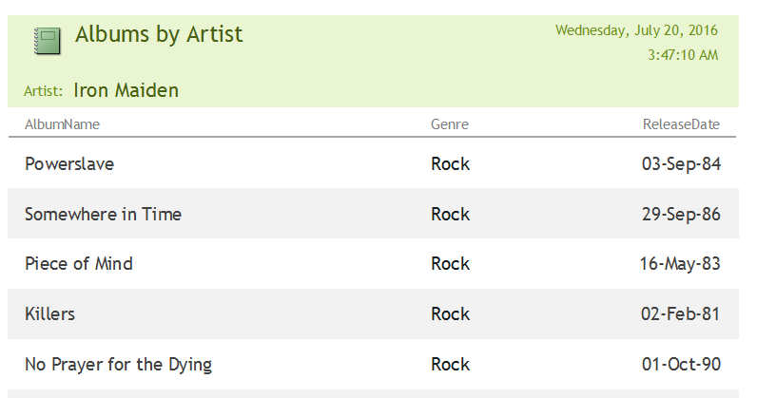
Database components
A form is a user interface design that allows users to hide the database behind a data entry form which allows users to find or add data.
A report allows data from a database to be presented in a more, clear and professional way. It removes the tabular structure and can output data in list form.

Slide 6
Analysing a client brief
Key terms:
A client brief is a document or communication provided by a client to a service provider to outline their requirements, objectives, and expectations for a particular project or service.
Learning in Context
A local taxi service would like a database to store all the data needed to run the business.
Create a system to keep track of drivers, customers and bookings. This needs to be easy to navigate and use. They want to be able to find specific information quickly and easily, such as the list of drivers and which days they work
and would like to create reports that they can share with their staff.
How to analyse the client brief
Read the brief carefully to understand the work required.
Break down the brief into different components, creating a checklist that helps to understand the client requirements.
Discussion
With the person next to you or on your own, read the brief and make a list of requirements.

Slide 7
Analysing a client brief
A local taxi service would like a database to store all the data needed to run the business.
Create a system to keep track of drivers, customers and bookings. This needs to be easy to navigate and use. They want to be able to find specific information quickly and easily, such as the list of drivers and which days they work
and would like to create reports that they can share with their staff.
A local taxi service requires a database.
The taxi database needs to store data about:
  Customers
  Bookings
  Drivers
A system that makes it easy to find data (e.g. information about drivers and when they work)
A method of creating a report to share with staff.

Slide 8
Success criteria
Key terms:
Success criteria are measurable indicators or benchmarks used to evaluate the success or effectiveness of a project
Learning in Context: Taxi service
Tables
Form
Queries
Report
How do break down the brief into success criteria?
Does any data need to be grouped into tables?
Does it need a form to create a user-friendly interface?
Which queries are needed if specific data needs to be searched for/found?
Is a report need to present the data?
Discussion
Look back at the taxi service brief, break down the scenario into success criteria using the guidance provided on the right.

Slide 9
Success criteria
Key terms:
Success criteria are measurable indicators or benchmarks used to evaluate the success or effectiveness of a project
Learning in Context: Taxi service
Tables | Tbl customers Tbl booking Tbl drivers
Form | A form to allow users to navigate through the different drivers. Use buttons to add and delete records.
Queries | To perform single, multiple and parameter queries about drivers, customers and orders.
Report | A report to show all the different bookings made.
How do break down the brief into success criteria?
Does any data need to be grouped into tables?
Does it need a form to create a user-friendly interface?
Which queries are needed if specific data needs to be searched for/found?
Is a report need to present the data?
Discussion
Look back at the taxi service brief, break down the scenario into success criteria using the guidance provided on the right.

Slide 10
Practice assignment
Streamistic are a multimedia online streaming platform that offers customers the opportunity to view a wide range of content using a pay-as-you-play service.
Streamistic has asked you to set up some IT systems to help the business run smoothly.
Create a system to keep track of products, customers and orders. This needs to be easy to navigate and use. They would like to be able find specific information quickly and easily, such as who has ordered which products in a certain month and would like to create reports that they can share with staff.
The movies available to stream are split into three different categories:
Category A – Gold: £3.50
Category B – Silver: £2.50
Category C – Bronze: £1.50
The following files provide a sample of the data kept by Streamistic. You will need to access these datasets as a starting point:
customers.csv
products.csv
orders.csv
Plan and design a database in response to the client brief.
You should:
analyse the requirements of the client brief
identify success criteria
Assessment criteria:
Award two marks for full identification of success criteria.
Award one mark for partial identification of success criteria.

Slide 11
Main task
Open the NEA Scrapbook 2.1 (Part A) and complete the following:
Analyse the client requirements. (Slide 2)
Identify the success criteria for this task and justify your choices. (Slide 3)
Use the worked examples from this presentation to support your analysis.

Slide 12

Terms of Use: Copyright Notice
© SIMPLY TEACH 2024
These Terms of Use govern the use of any material, content, or intellectual property provided by Simply Teach. By accessing or using the Material provided by Simply Teach, you agree to be bound by these Terms of Use.
Copyright Notice: All Material provided by Simply Teach is protected by copyright laws. All rights are reserved by Simply Teach.
Non-Redistribution: You may not redistribute, reproduce, republish, transmit, distribute, or otherwise use the Material provided by Simply Teach without prior written permission from Simply Teach.
No Public Domain Usage: The Material provided by Simply Teach is not released into the public domain. You may not use, modify, or distribute the Material in any way that would place it in the public domain.
Intellectual Property Rights: All intellectual property rights in the Material, including but not limited to copyrights, trademarks, patents, and trade secrets, belong to Simply Teach. You agree not to infringe upon these rights in any way.
Contact Information: If you have any questions about these Terms of Use, please contact Simply Teach
By accessing or using the Material provided by Simply Teach, you acknowledge that you have read, understood, and agree to be bound by these Terms of Use. If you do not agree to these terms, you may not access or use the Material.

